Slide 1
Arizona Independent Redistricting Commission
Analysis of Round Two of Public Hearings
11/29/11

Slide 2
Types of Public Input
Public Meetings
Actual testimony
Additional material handed in
Public Hearings (Round 2)
Actual testimony
Blue Sheets handed in
Additional material handed in
Web Submissions
Snail Mail
Phone
Fax
Hand Delivered
Goal is to ensure everyone who voiced an opinion is heard for the mapping process.

Slide 3
Summary
Round Two - By the numbers
Dates | October 11 through November 5
Number of Cities | 30 (includes 1 satellite location)
Total spoken comments | 813
Number of Blue Sheets handed in | 396
Number of people who signed in | 2119
Age range of comments | 13 to 92 years
Public hearings in minutes | 3655
Average meeting Length | 2 hours 6 minutes

Slide 4
Word Clouds
Based on how often words are recorded in the transcripts
Certain words are removed (non-verbal formatting)
Do not show whether an opinion is negative or positive, simply how often it was said

Slide 5
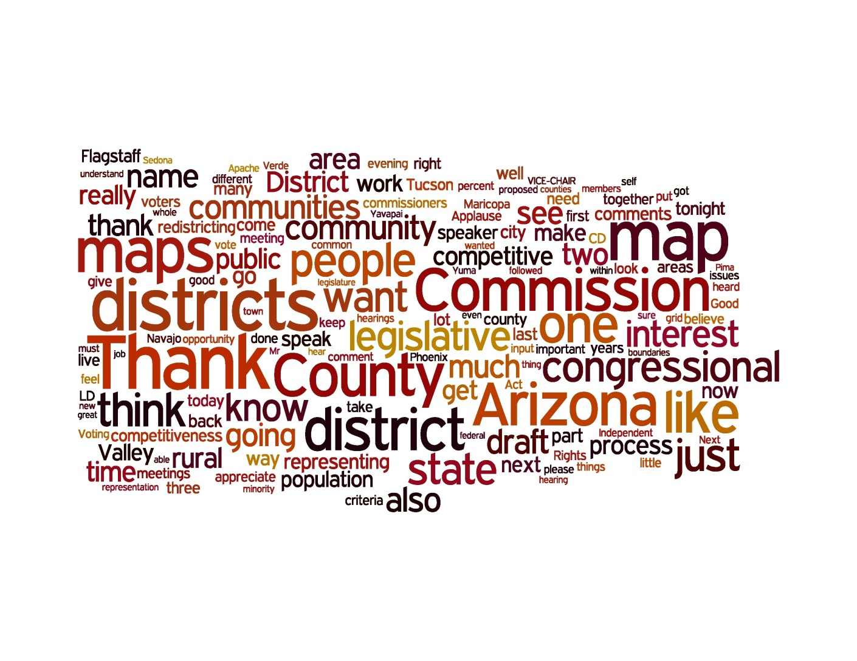
Round 2 - Statewide

Slide 6
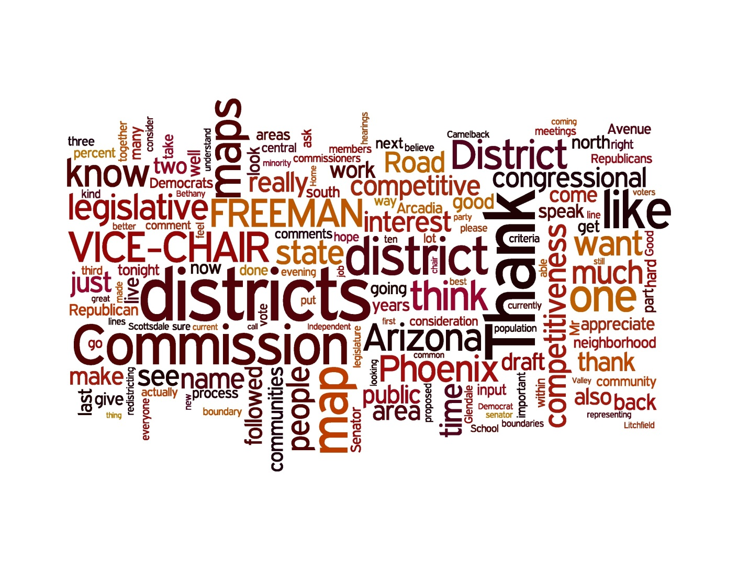
10/11 – Phoenix (36)
  A number of people expressed appreciation for the maps and the work the commission put into the process
  There were a number of tweaks around the edges that came out of this meeting with some very specific examples given in the testimony
  Some citizens expressed a need for more competitive districts

Slide 7
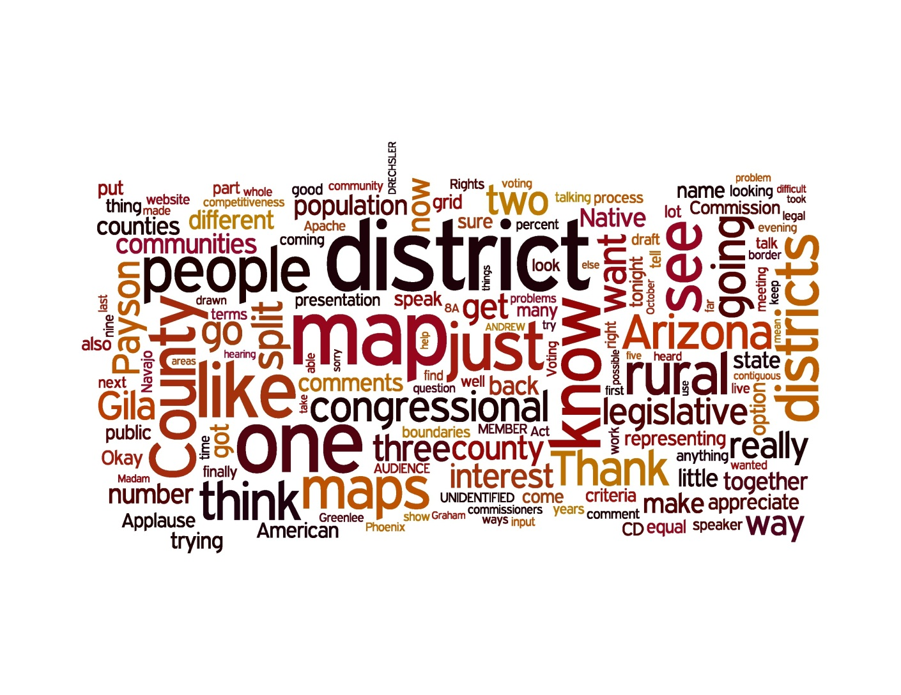
10/12 – Payson (12)
  There was concern about Gila County being split into three districts in the LD map
  There was some concern about CD1 being too large for someone to effectively serve the district

Slide 8
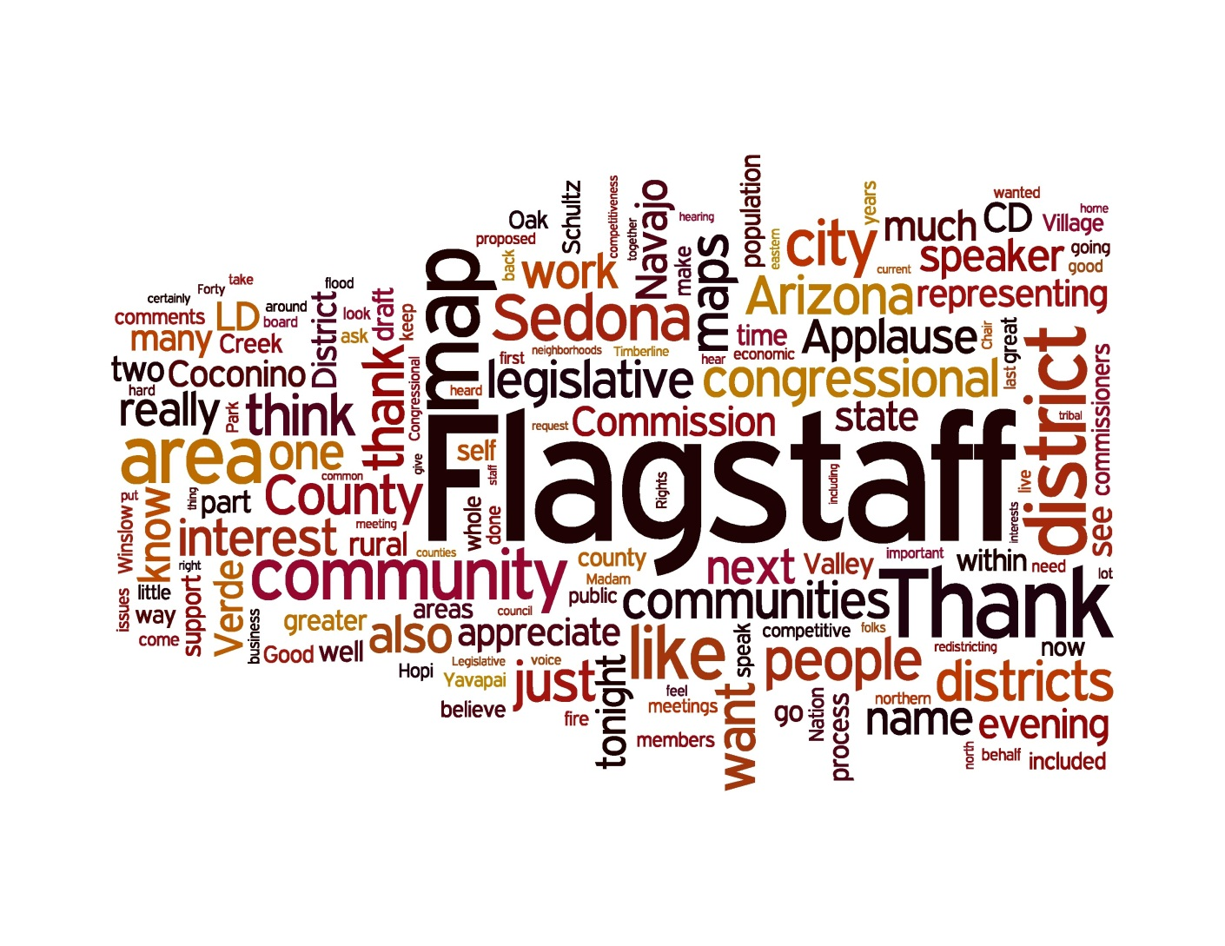
10/13 – Flagstaff (54)
  A number of citizens expressed appreciation of the maps, both CD and LD
  One change that was brought up a number of times is a desire to have the Shultz Fire and Flood area be with Flagstaff on the LD map. Along the same lines, Fernwood and Timberline should be with Flagstaff
  Moving to the South, there was a desire from some to have Cottonwood be with Flagstaff

Slide 9
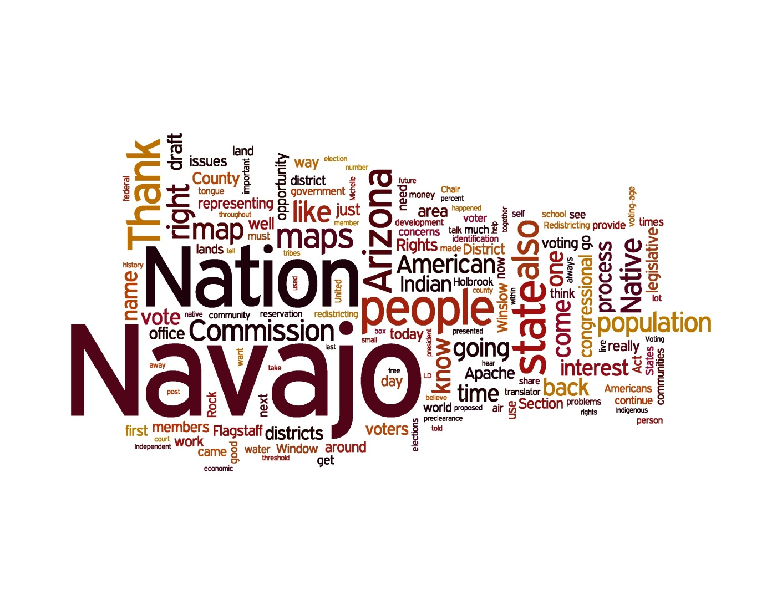
10/14 – Window Rock (21)
  A number of citizens expressed support for the maps, especially since the Native American percentage is higher in both the LD and CD maps than the current maps

Slide 10
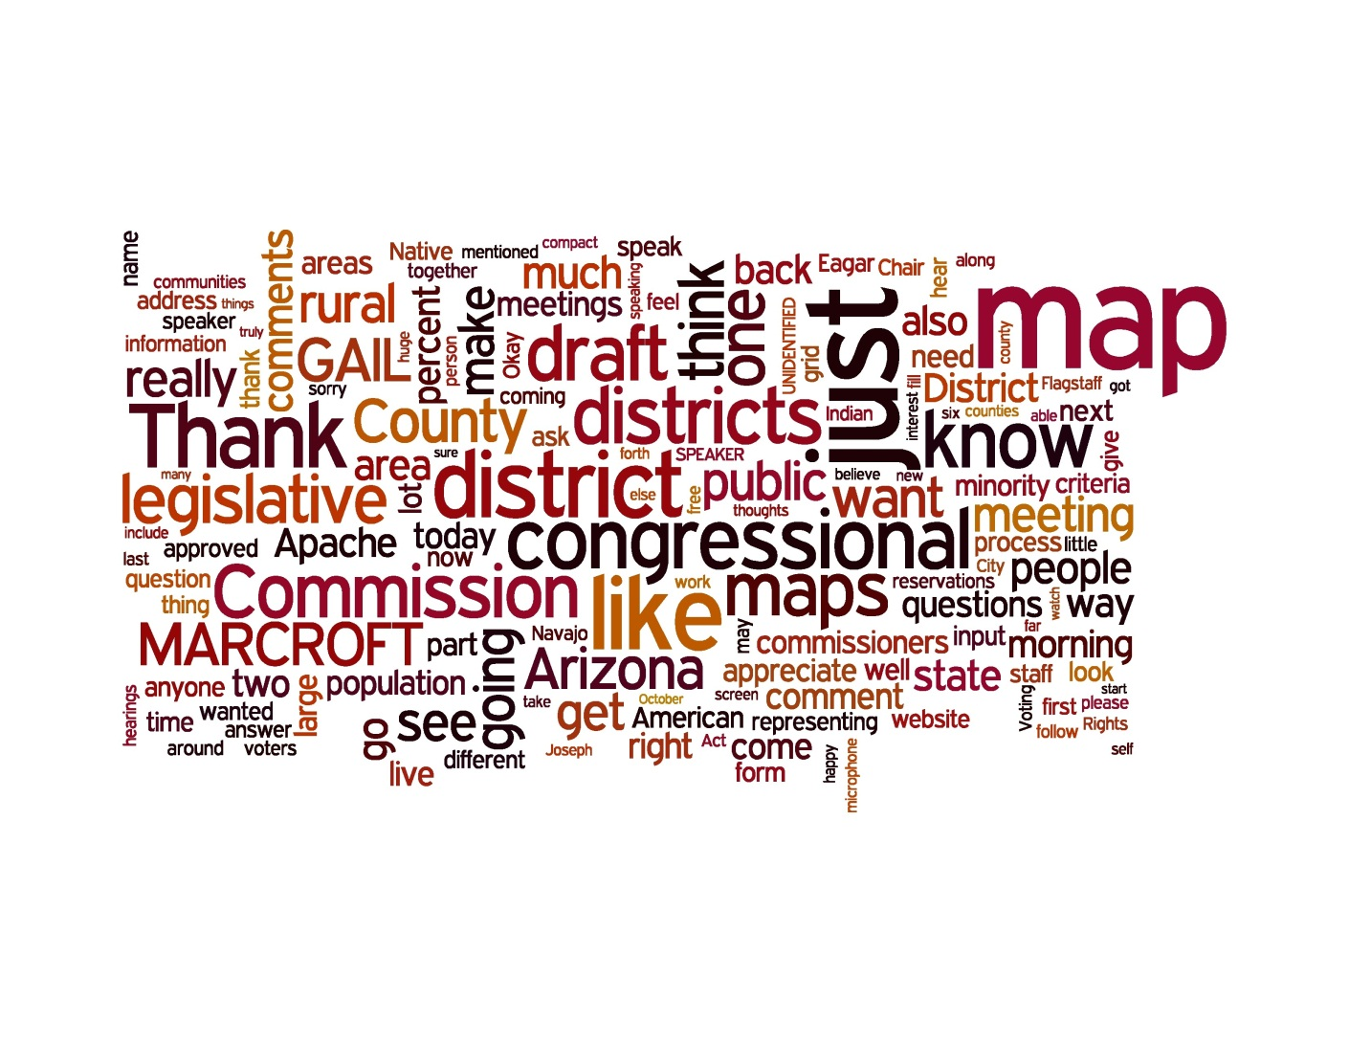
10/15 – Eager (11)
  There is concern that CD 1 covers a lot of land but yet there was a lot of support for two rural districts

Slide 11
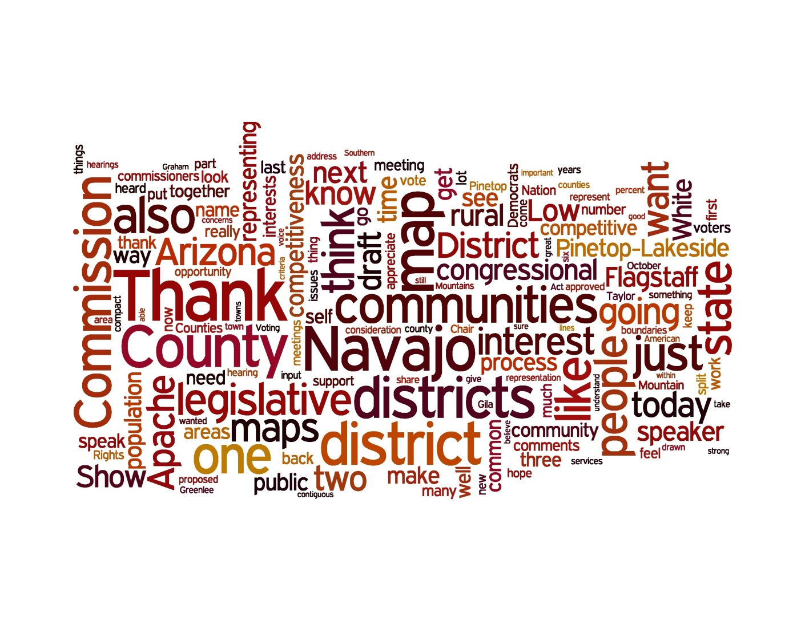
10/15 – Hon Dah (27)
  A number of people expressed a desire to see Show Low kept with LD 7 or at least with Pinetop-Lakeside
  There were comments that the maps did not seem compact
  There was a desire to see more competiveness in the maps

Slide 12
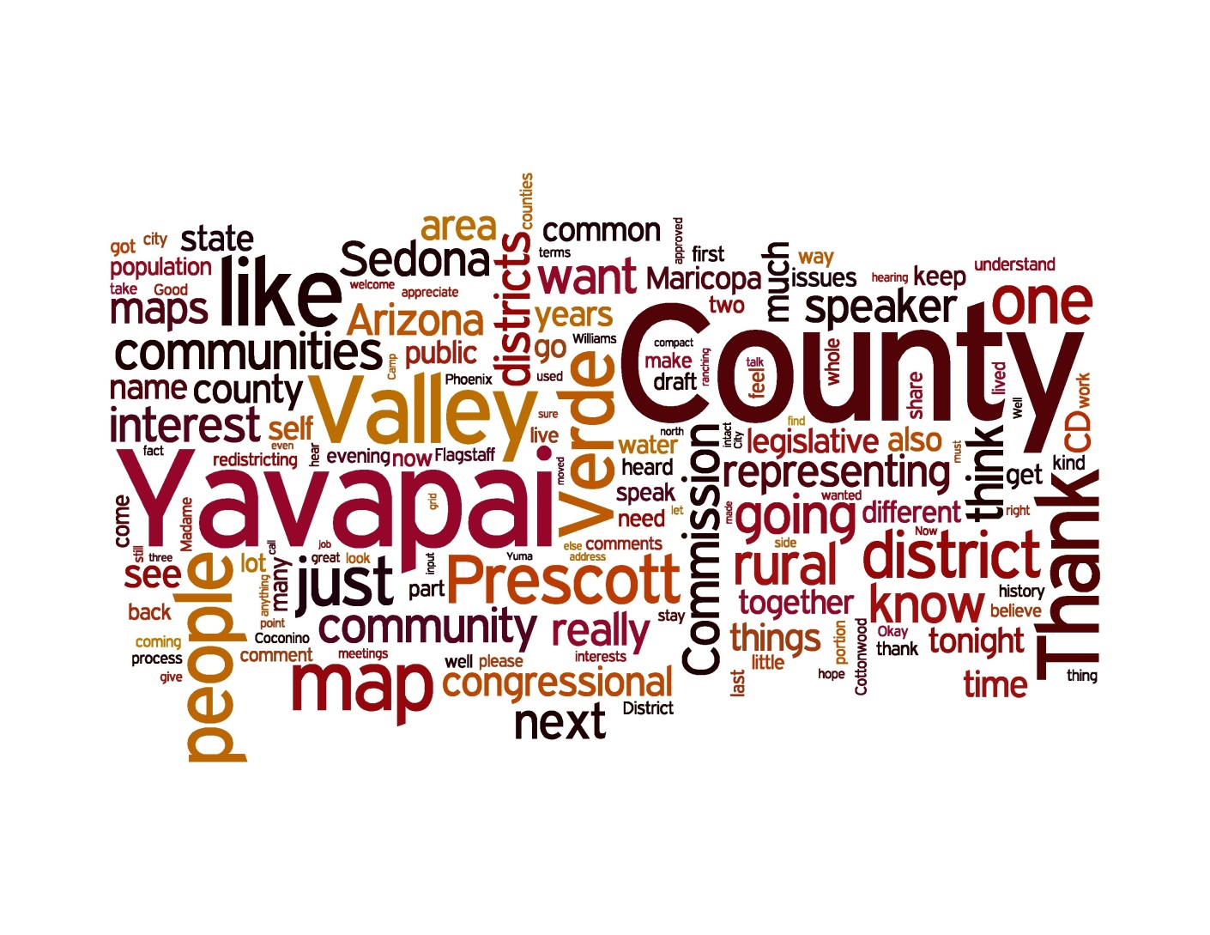
10/17 – Prescott Valley (46)
  Concern that Yavapai was broken up since the county population was similar to LD seat
  There was a desire to keep Yavapai whole, thus bringing back the NE corner and losing Maricopa County
  There was a request to make LD1 and CD1 in Yavapai county to keep the tradition going

Slide 13
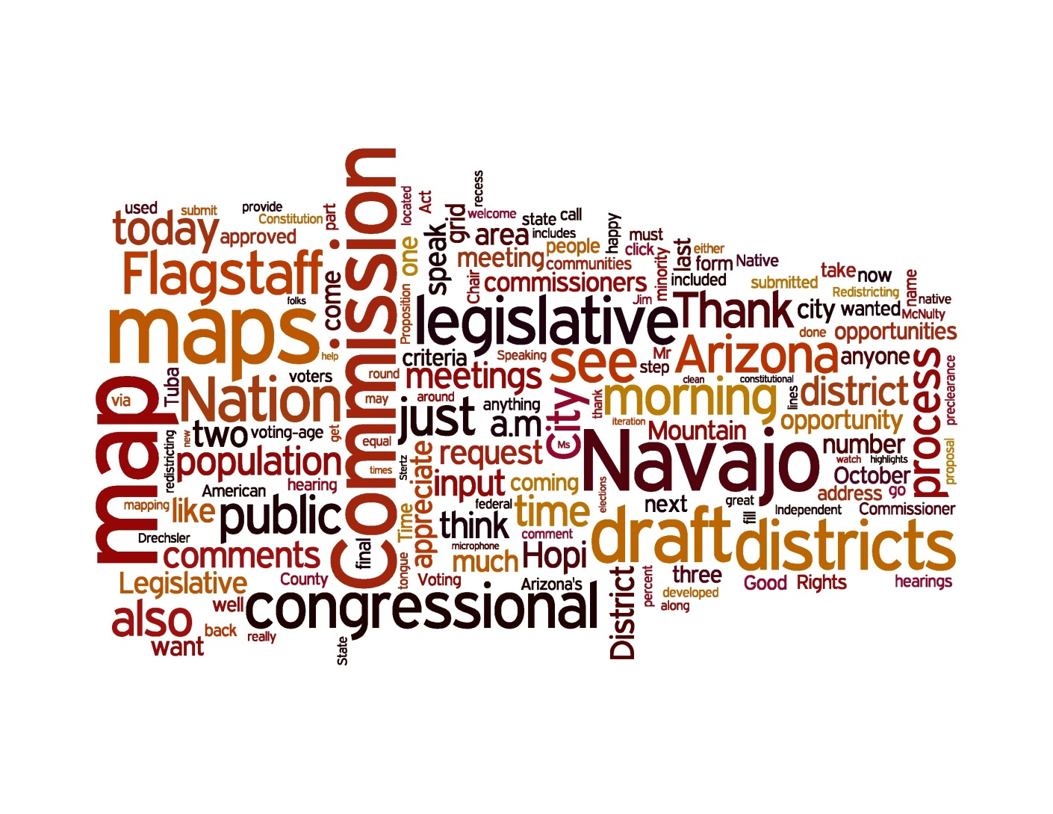
10/17 – Tuba City (2)
  Support for the maps as the a number of Tribes are kept together

Slide 14
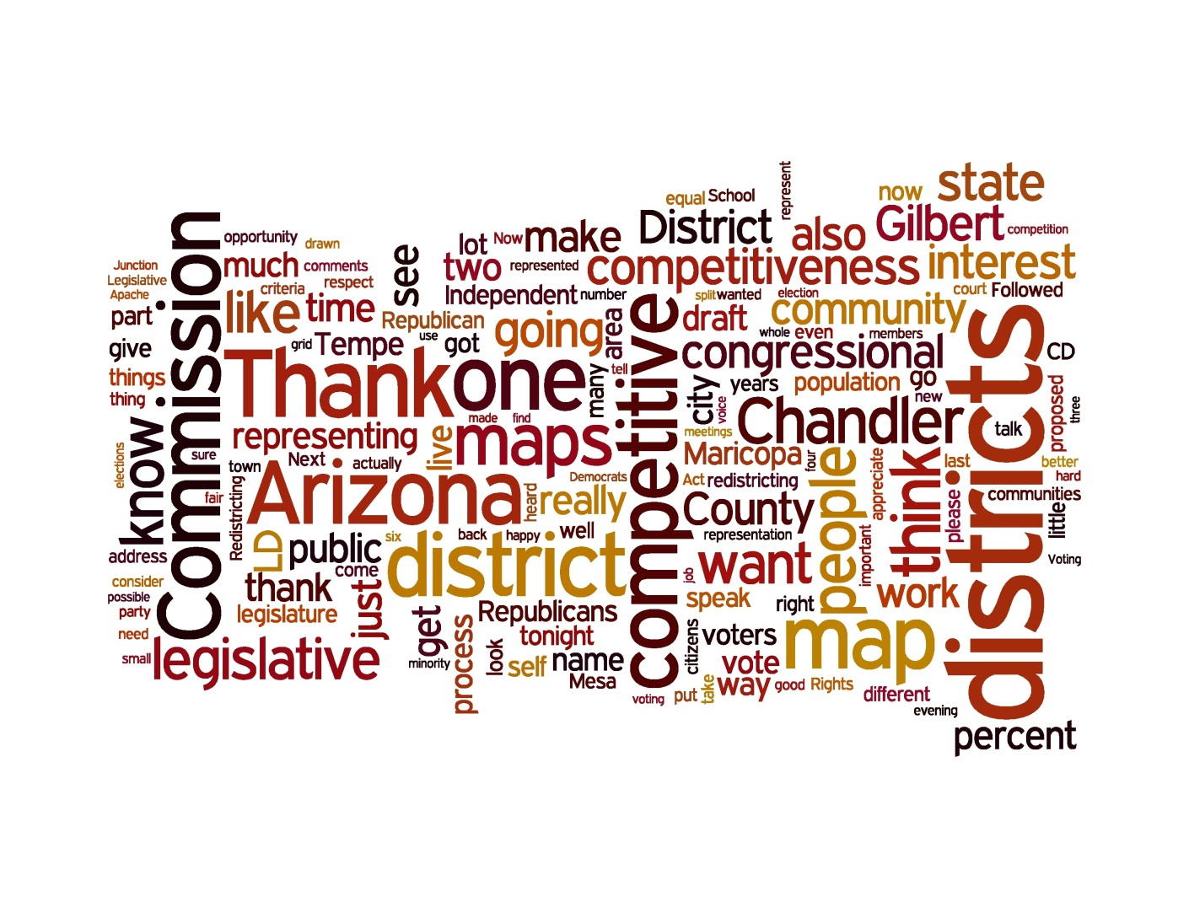
10/18 – Chandler (38)
  Those from Chandler expressed support for the maps as it kept Chandler together
  A number of citizens expressed a desire for more competitive maps. They were concerned that there are too many safe seats for each party

Slide 15
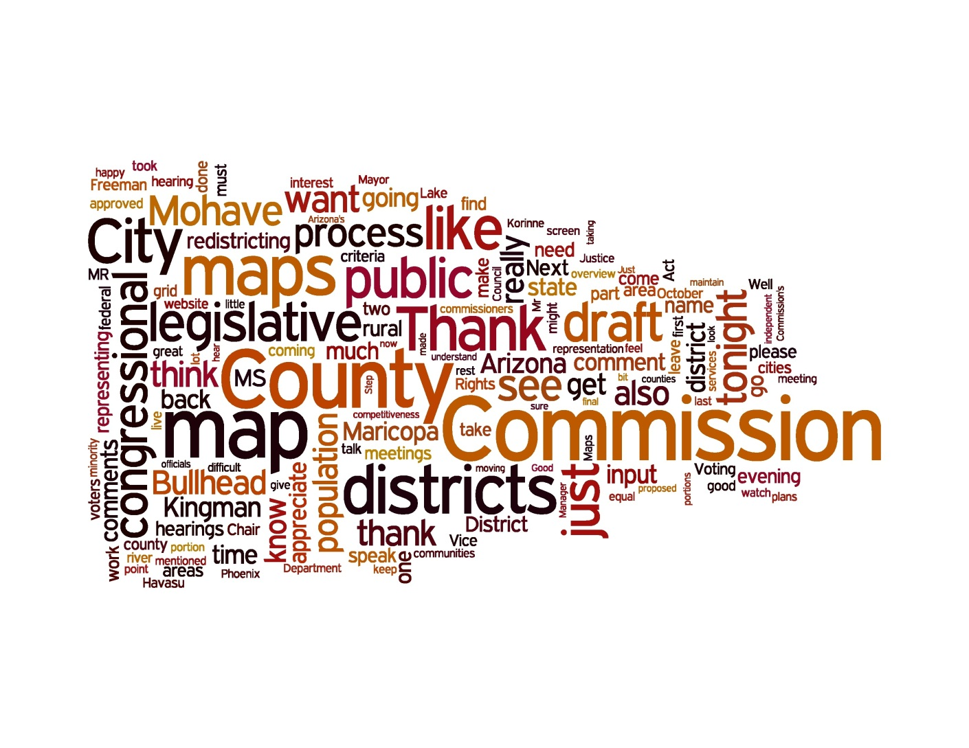
10/19 – Bullhead City (11)
  There was a sense that the River Cities needs were addressed and kept together

Slide 16
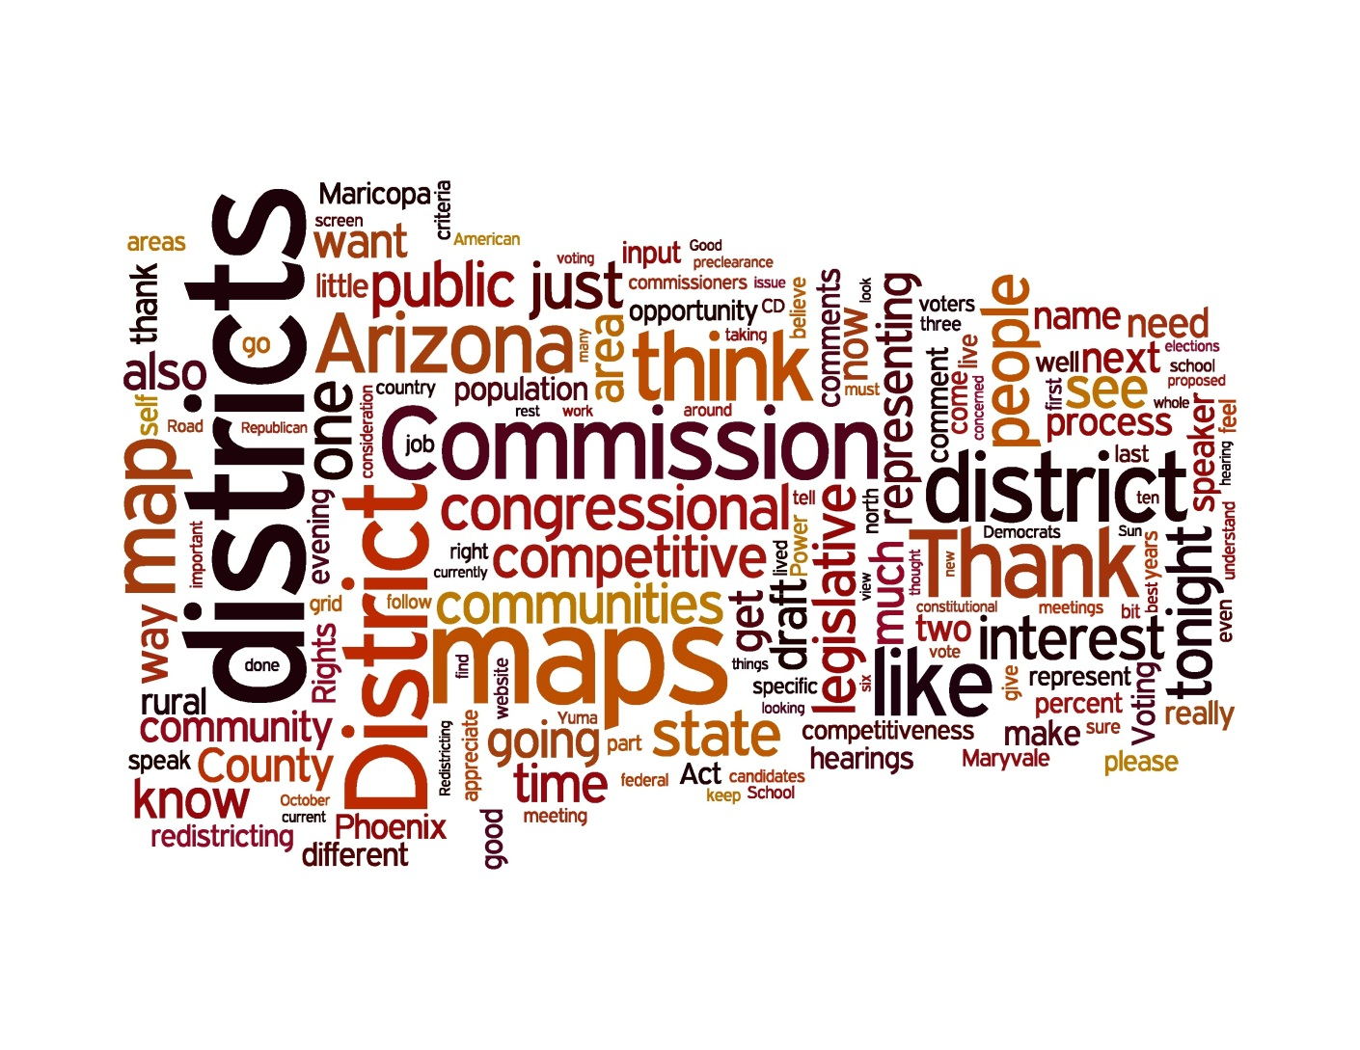
10/20 – Maryvale (15)
  There were a number of specific comments on how the borders should be slightly tweaked
  There was a desire to see more competitive districts

Slide 17
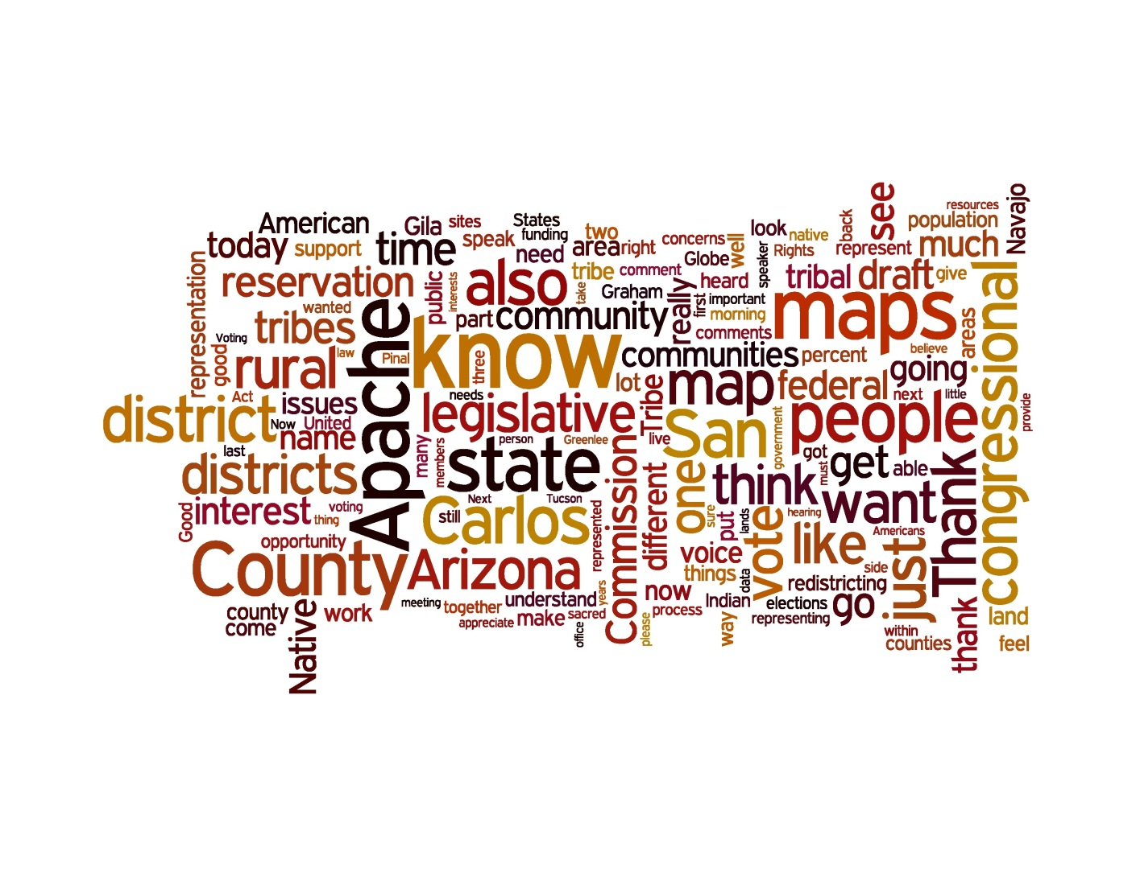
10/21 – San Carlos (28)
  There was support for the LD and CD maps by a number of representatives of the San Carlos Apache Tribe
  Ideally, counties are not split as much (Gila and Graham)

Slide 18
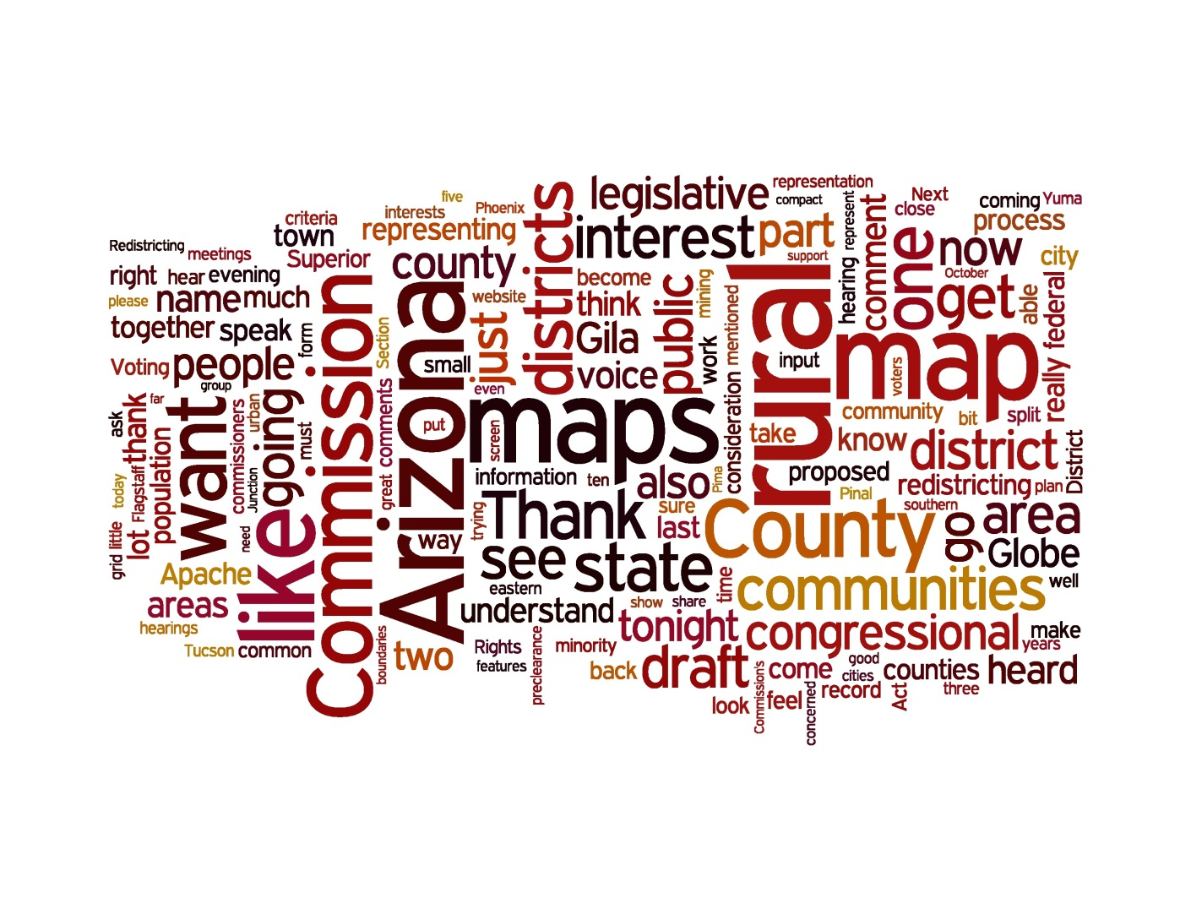
10/21 – Globe (15)
  There is a general concern that the rural voice is not being heard and there was a number of communities of interest expressed shared during the meeting. Ranching, mining, timber were specifically mentioned.

Slide 19
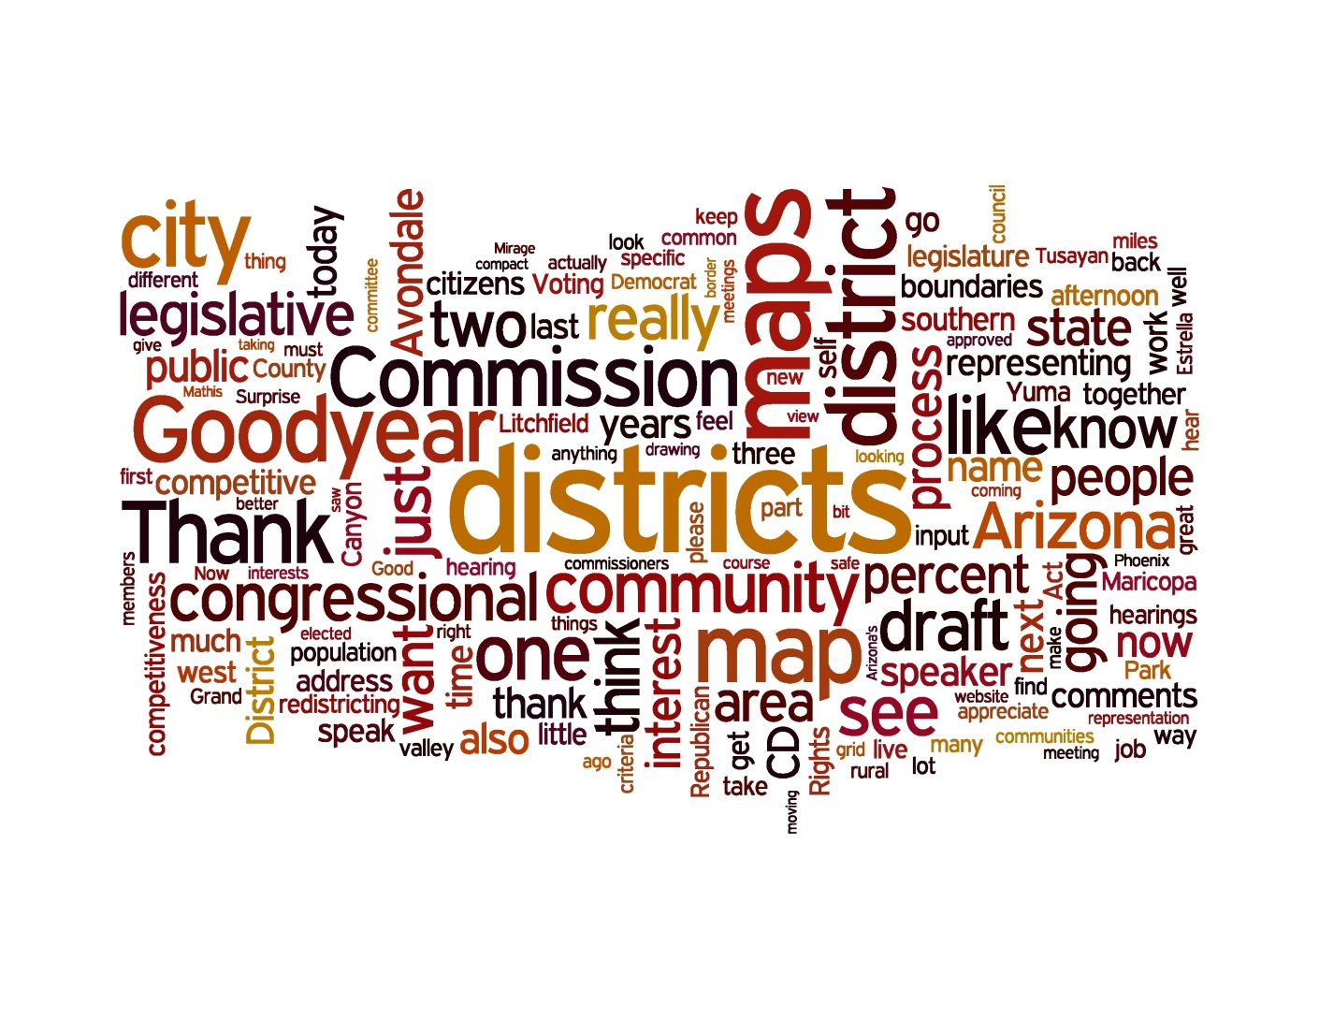
10/22 – Avondale (17)
  Concern that Avondale is with Yuma, people do not see that as a community of interest
  Concern that Goodyear is split and also noted that Goodyear should not belong with a rural area

Slide 20
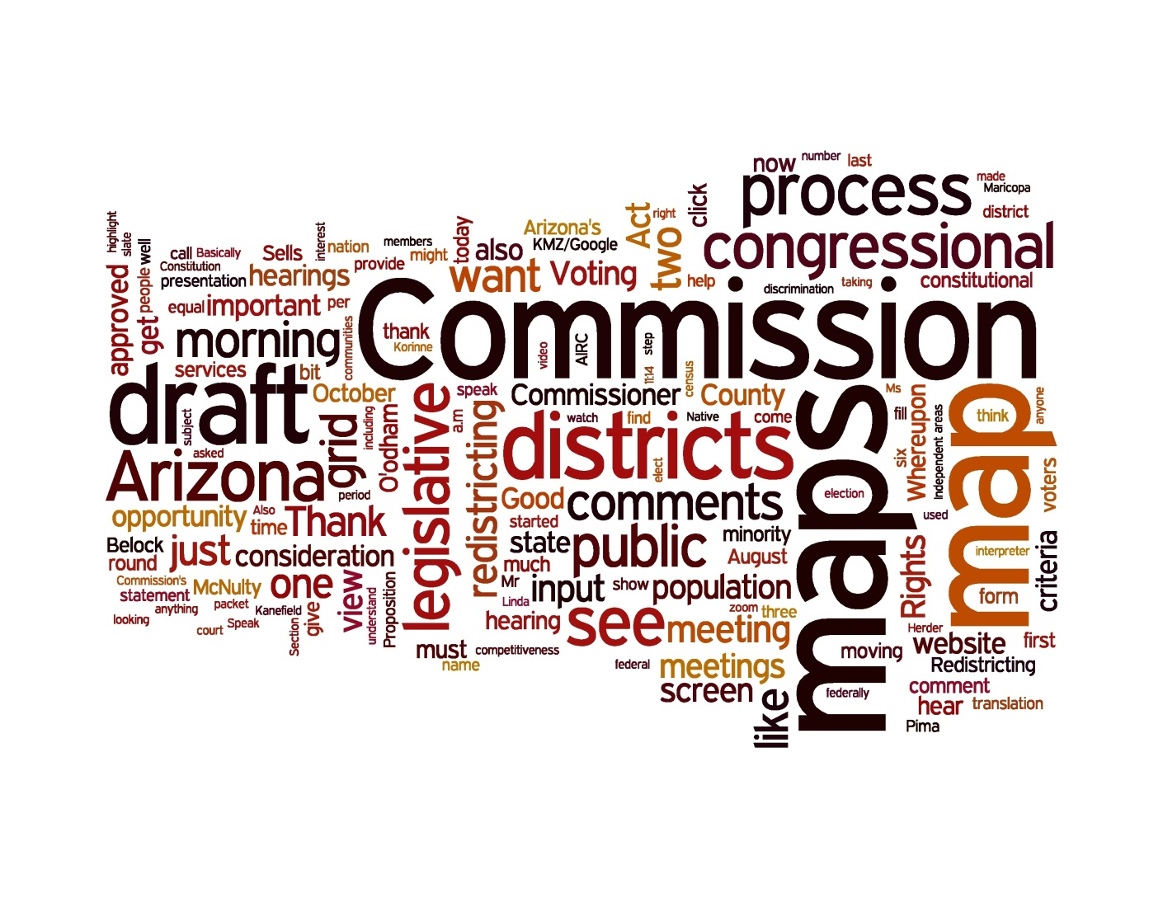
10/24 – Sells (1)
  A desire for competitive districts and districts that are sensitive to the tribes

Slide 21
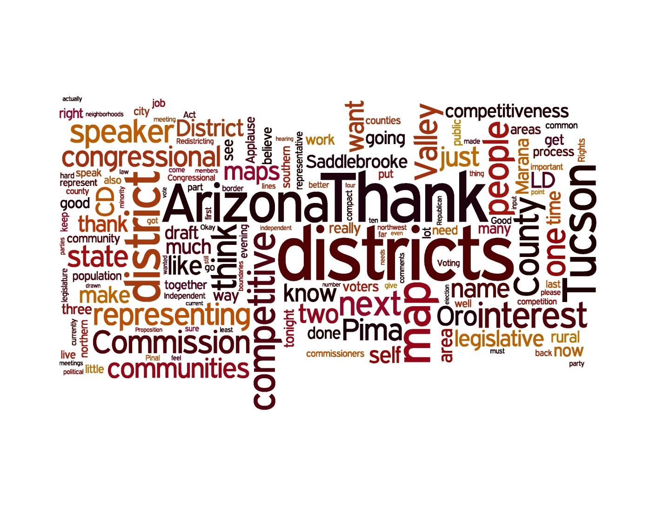
10/24 – Tucson (79)
  Large voice supporting the maps but wanted to see them be more competitive
  Large voice that felt that CD1 was too big and should be more compact

Slide 22
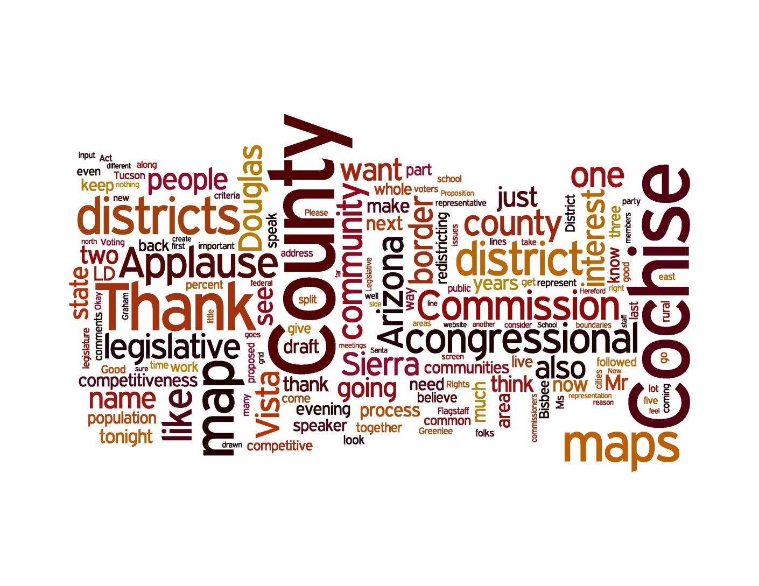
10/25 – Sierra Vista (50)
  Resounding support to keep Cochise County whole

Slide 23
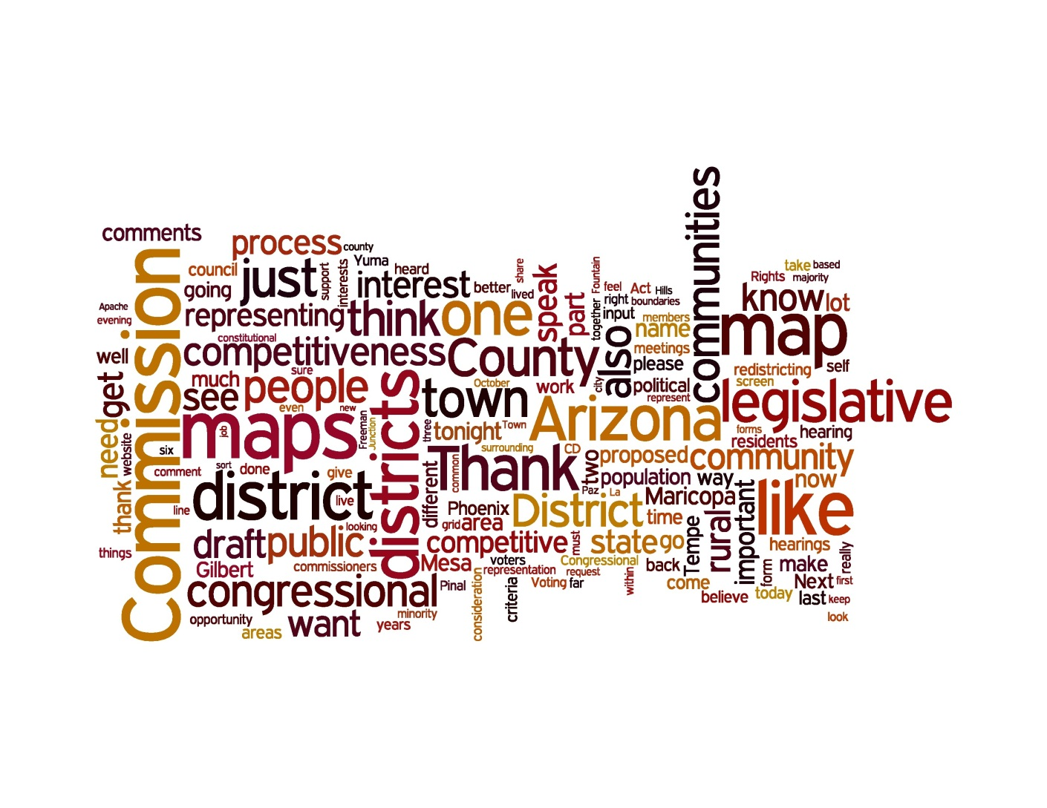
10/26 – Mesa (21)
  A number of specific requests from citizens who traveled to Mesa
  A lot of support for more competition in the maps

Slide 24
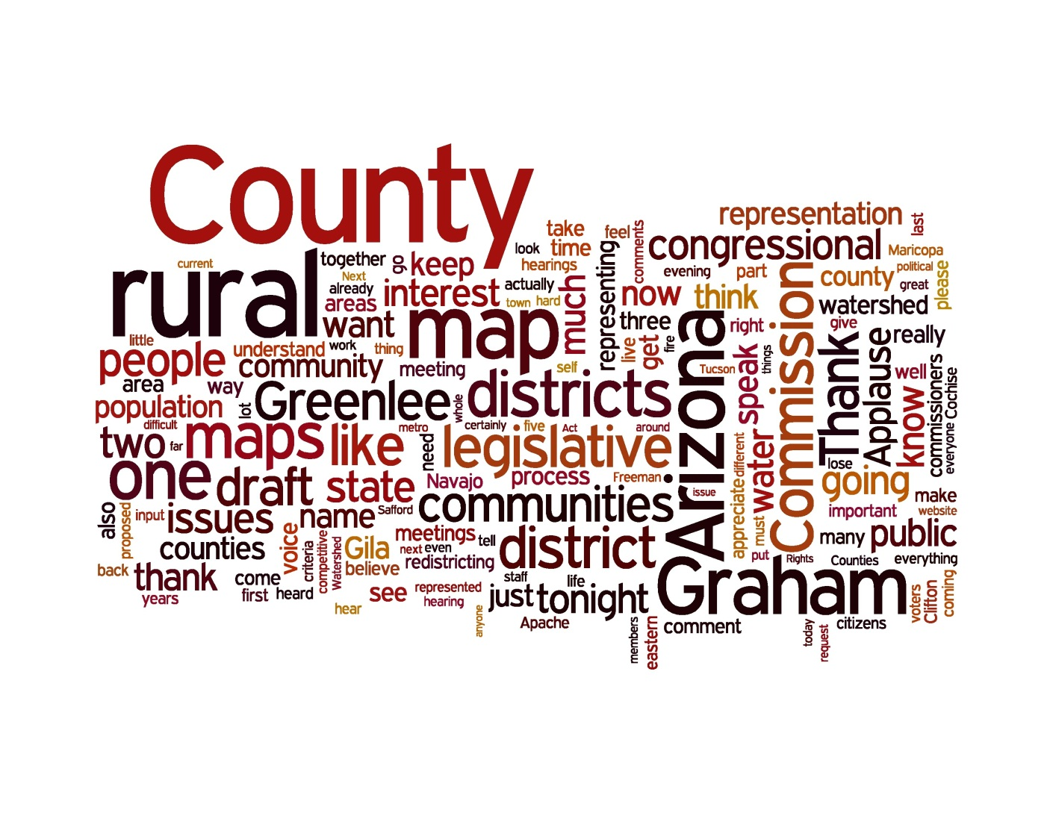
10/27 – Safford (23)
  Graham County needs rural representation that understands rural issues
  Keep Graham and Greenlee counties together, they are a Community of Interest

Slide 25
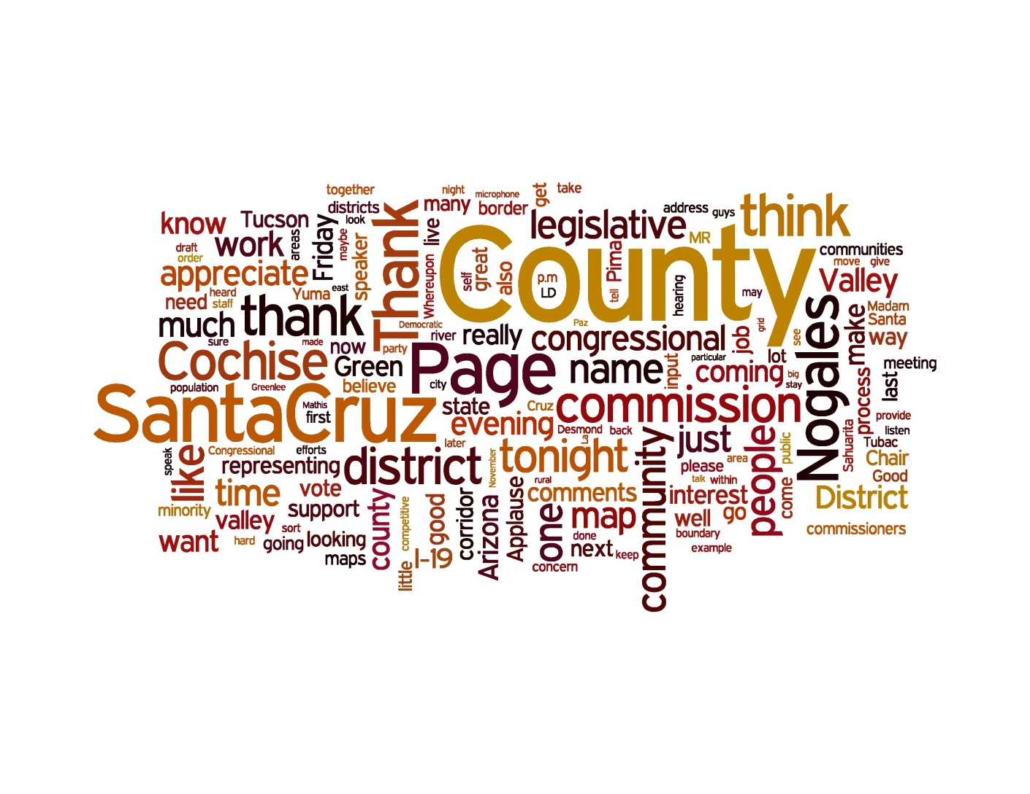
10/28 – Nogales (10)
  Thanked the commission for their work
  Please consider the Interstate 19 corridor and Santa Cruz River Valley Communities of interest and keep them together

Slide 26
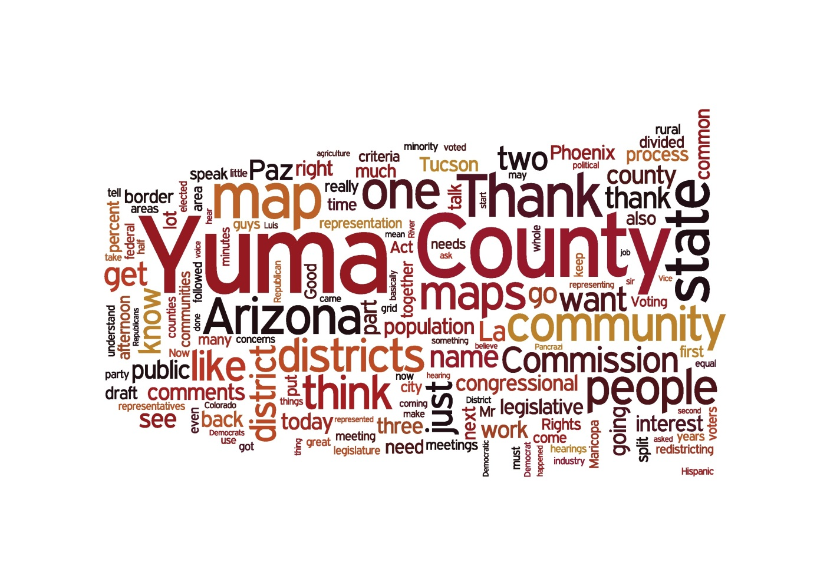
10/29 – Yuma (39)
  Keep Yuma County whole and with LaPaz County
  People are upset with the IRC because it is biased- the maps should be redrawn
  South Yuma County has more in common with other border areas and should be in a Voting Rights District

Slide 27
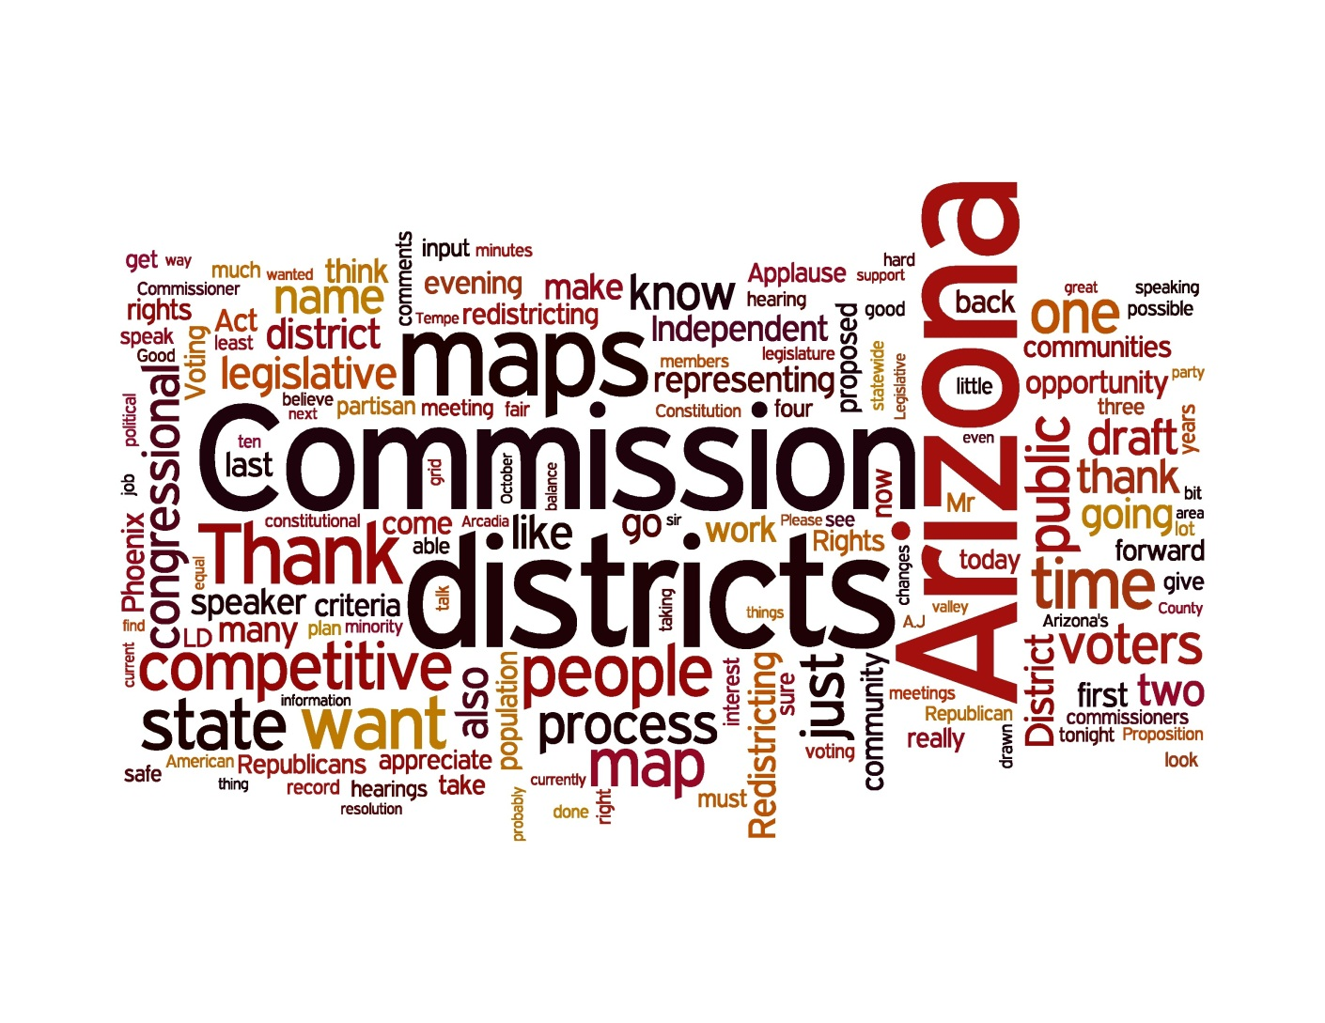
11/1 – South Phoenix (16)
  Upset that the Governor and Legislature are trying to derail the commission
  Thanked the commission for their work
  The Voting Rights Act is very important and should be a main consideration
  Need more competitive districts

Slide 28
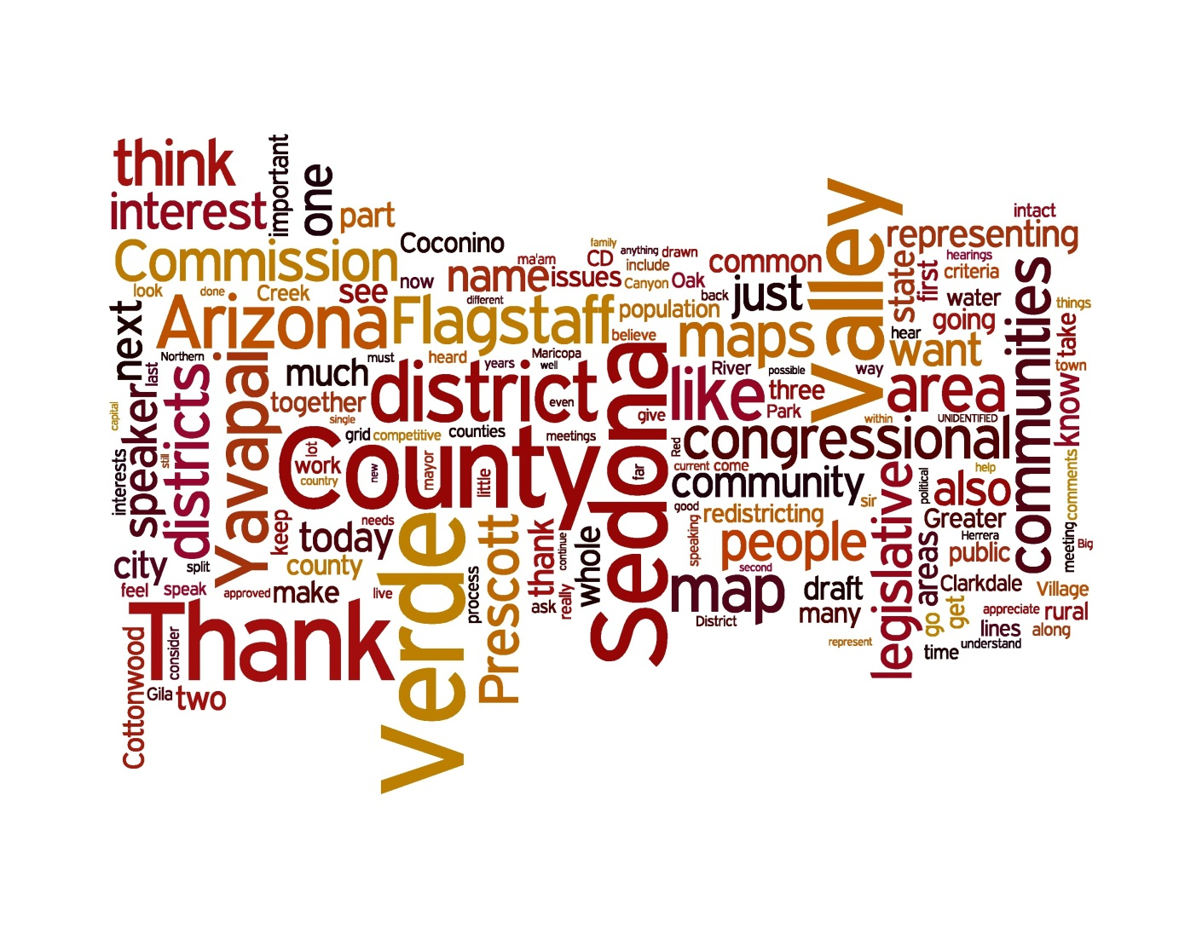
11/2 – Cottonwood (42)
  The Verde Valley should be kept whole and with Flagstaff, they don't have anything in common with Prescott
  Keep Yavapai County whole, don't split off the Verde Valley, they share common water issues and history
  Many people thanked the commission for their work
  Many people were upset with the commission and think it should be changed

Slide 29
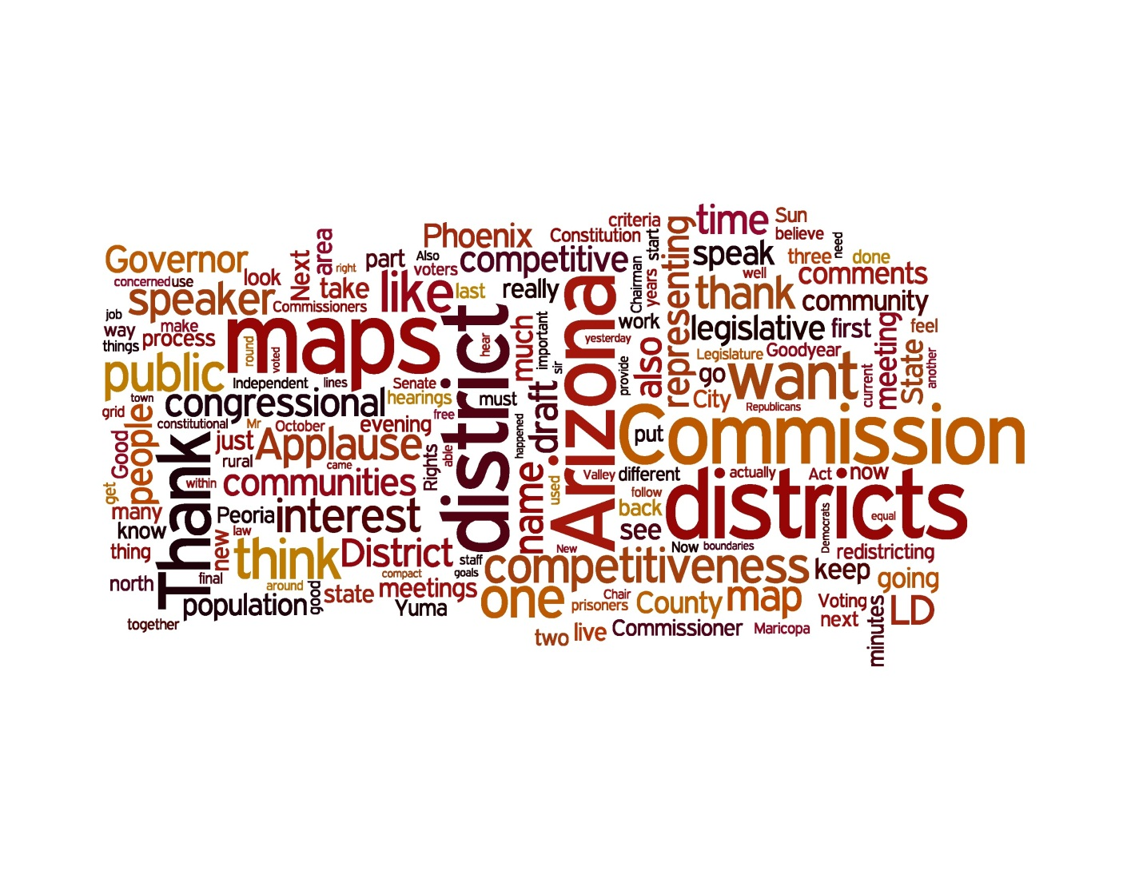
11/2 – Peoria (20)
  Many comments offered specific changes that they would like to see adopted
  Need more competitive districts / to much emphasis on competitive districts
  Thanks the commission for its hard work

Slide 30
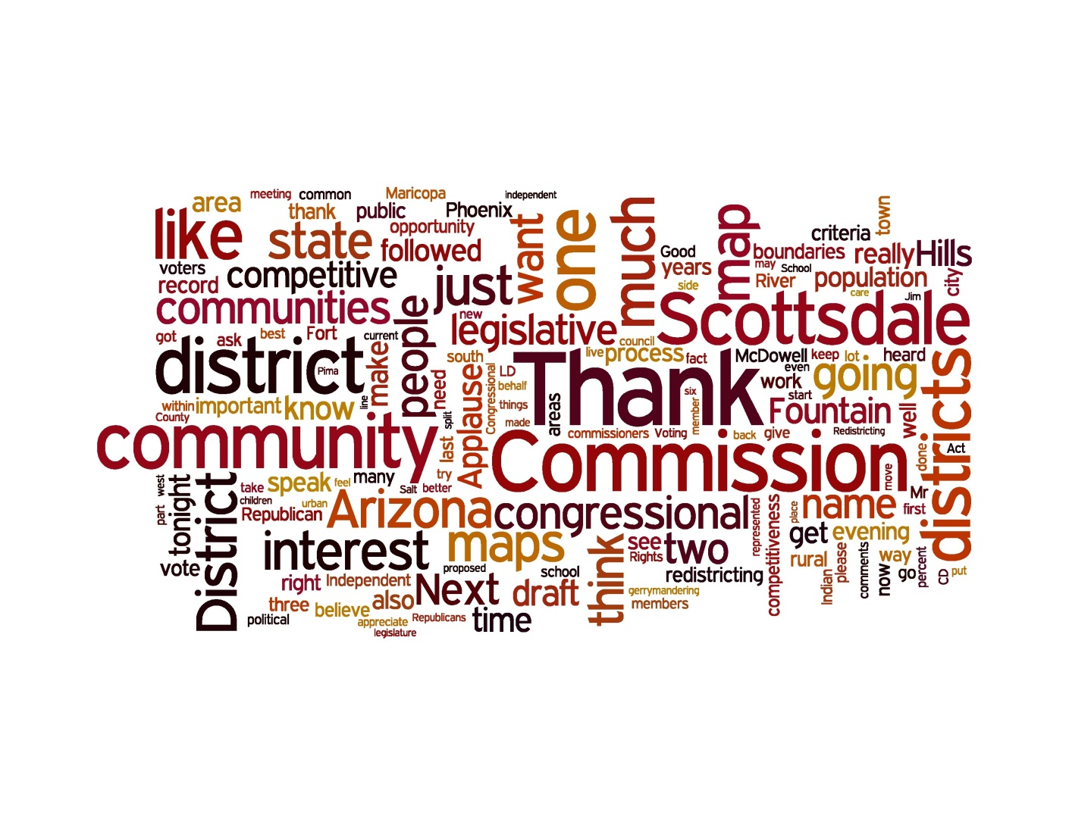
11/3 – Scottsdale (73)
  Competitiveness was cited a number of times, those who feel it is considered too high but more comments in support of more competitive
  There was concern that Fountain Hills was in CD4 and that it should be put with a eastern rural district

Slide 31
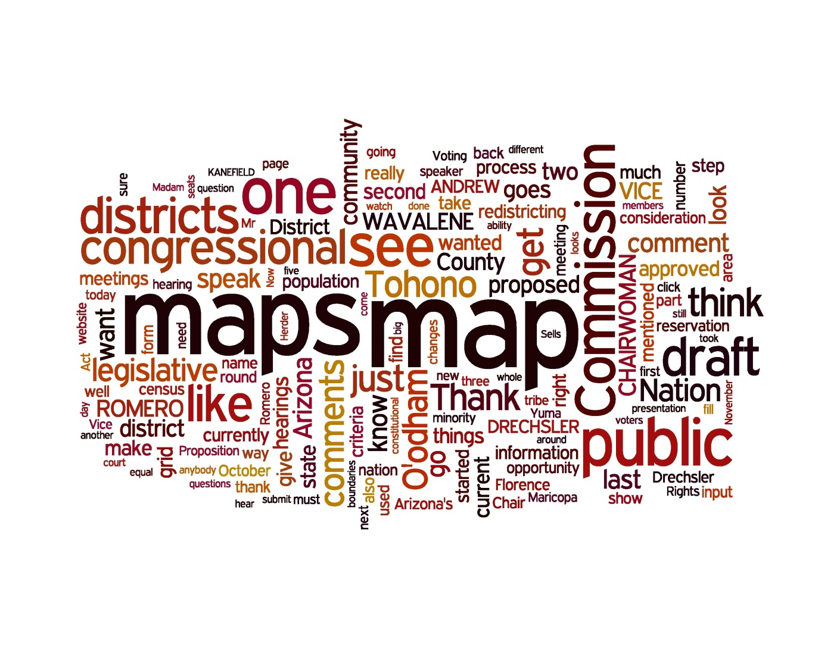
11/4 – Sells (1)
  A desire to see the tribe kept together in one CD

Slide 32
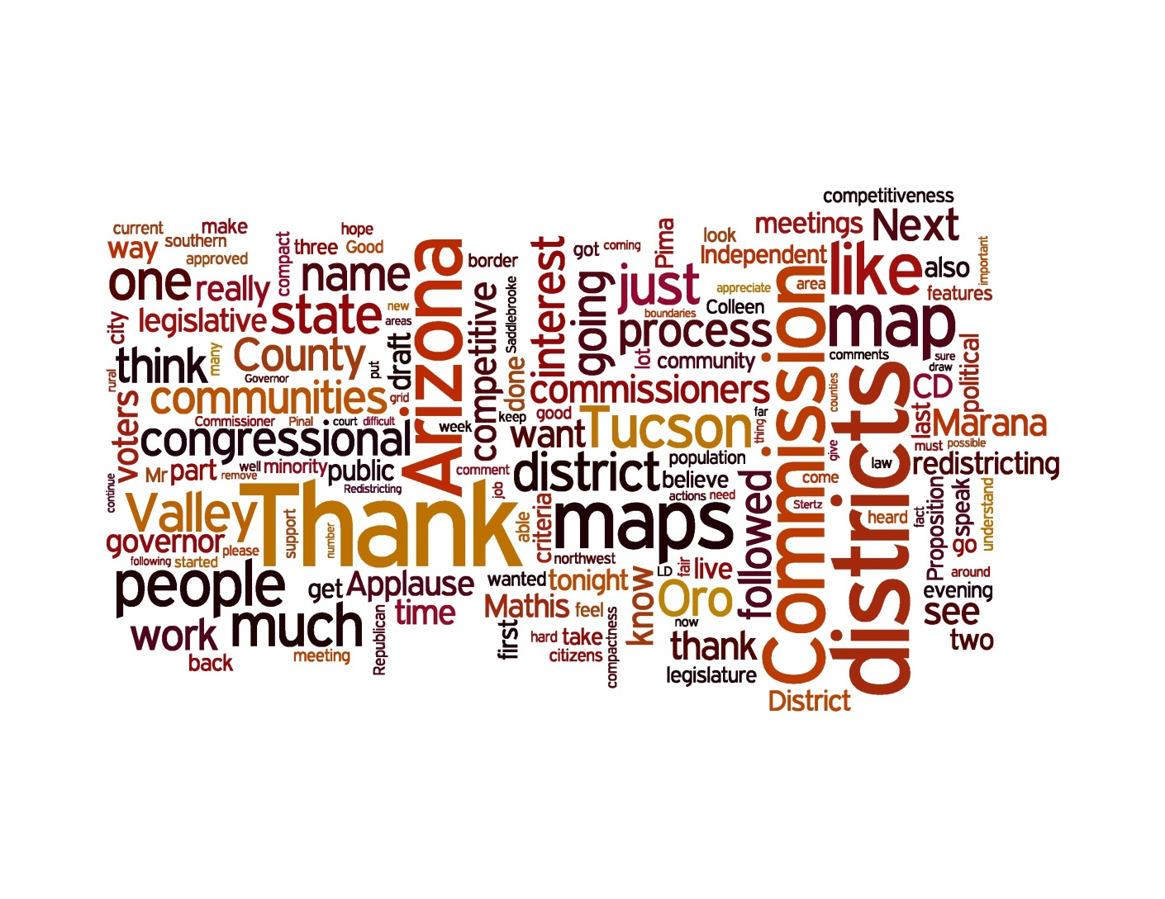
11/4 – Marana (45)
  A number of people expressed support for the Commission and condemned the actions of the Governor
  There was concern how Marana, Oro Valley were with CD1 and not with Tucson
  Felt that CD1 is not compact

Slide 33
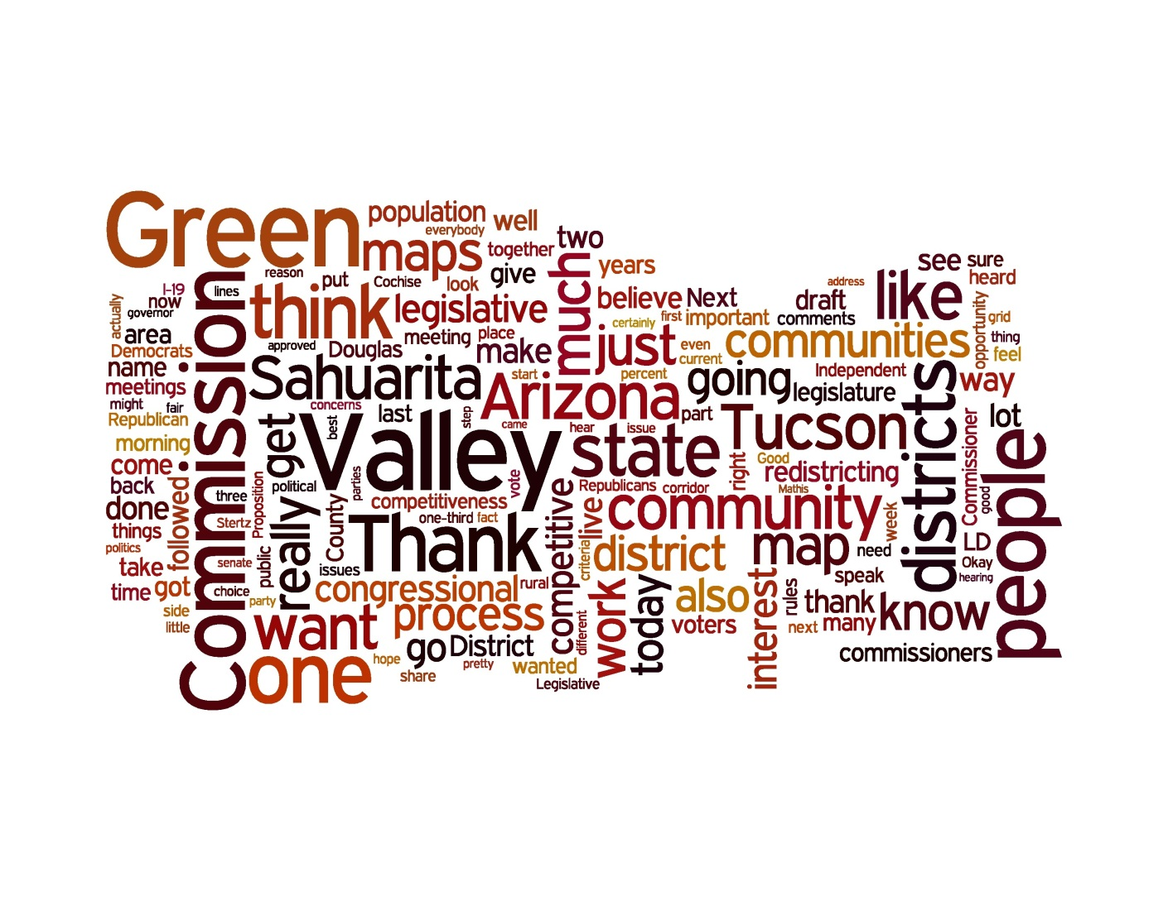
11/5 – Green Valley (31)
  A lot of people want Green Valley to be with Sahuarita and vice versa
  Overall there was a feel that Green Valley and Sahuarita should be with Tucson and are not rural
  There was a lot of support for the Commission and disappointment in the actions of the Governor and State Senate

Slide 34
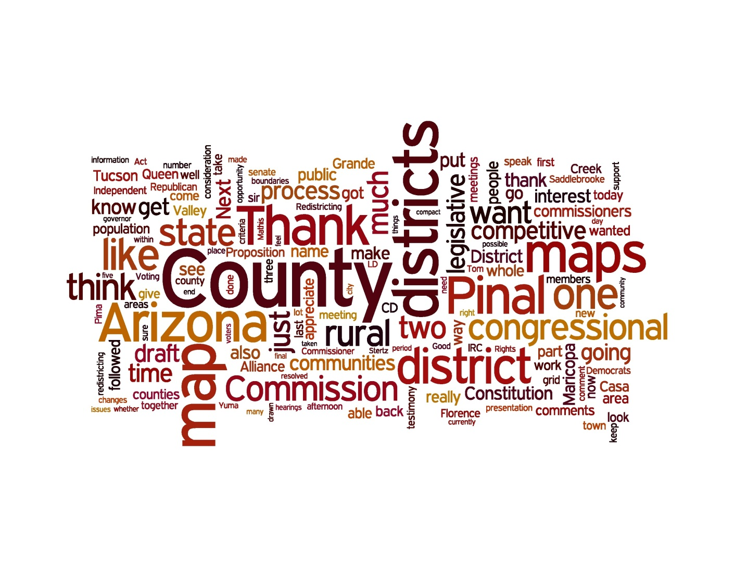
11/5 – Casa Grande (29)
  A variety of different comments at this meeting, there was support for keeping Pinal County whole
  There was a number of people who expressed support commission

Slide 35
In total there have been over 6,500 comments collected and cataloged by the commission.

